Slide 1
WELCOME

Slide 2
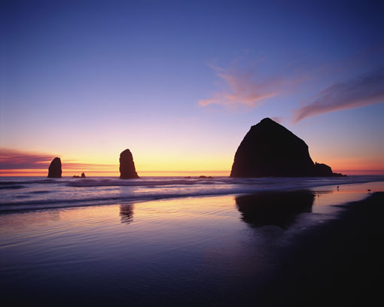
Prayer

Slide 3
REVIEW of what’s happened so far.
vocation through baptism
Living a Life that matters

Slide 4
Lay Associations – The story of what has happened so far worldwide
Called to Holiness
Canonisation of Eugene.
Maintaining connections to the Oblates

Slide 5
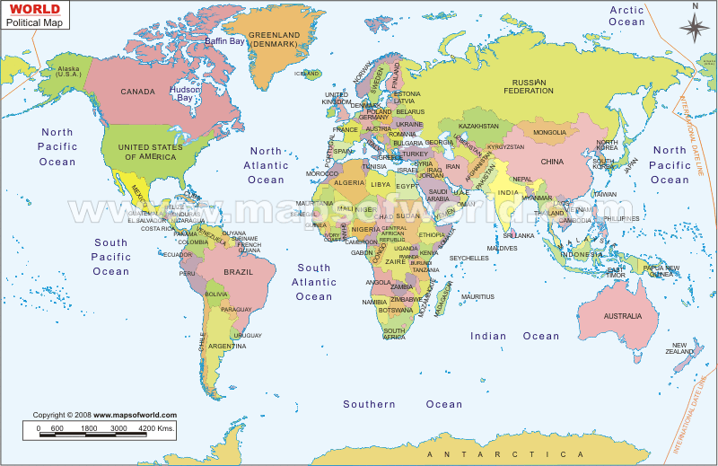
Worldwide interest

Slide 6
Rule 37a
Lay people share in the charism of St. Eugene…
Communion and reciprocity.
Gather in associations.

Slide 7
Lay associates at Chapters since 1998
2010

Slide 8
Two Congresses
Aix-en-Provence ( 1996)
Rome (2007)

Slide 9
Identity of Lay Associates
The Identity statement – Congress (1996)

Slide 10
How the development is foreseen
Movement from dependence to partnership.
Move from being co-operators to being fellow disciples

Slide 11
Fr. William Steckling OMI’s 4 aspects
A clear identity..
A solid spiritual life…
A community….
A Mission…

Slide 12
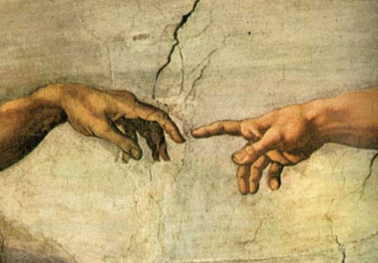
Brainstorm “Friendship

Slide 13
Exploring “The Identity of Lay Associates”
IMPASSIONED FOR CHRIST

Slide 14
The way forward in the Anglo-Irish Province

Slide 15
The invitation to join

Slide 16
Date of next meeting –
7pm for 7.15pm – 8.30pm

