Slide 1

“MISSIONARY OBLATE OF MARY IMMACULATE”
What’s in a name?

Slide 2

THE OBLATE FAMILY
brother oblate
lay oblate
sister
oblate
married oblate
priest oblate
youth oblate

Slide 3
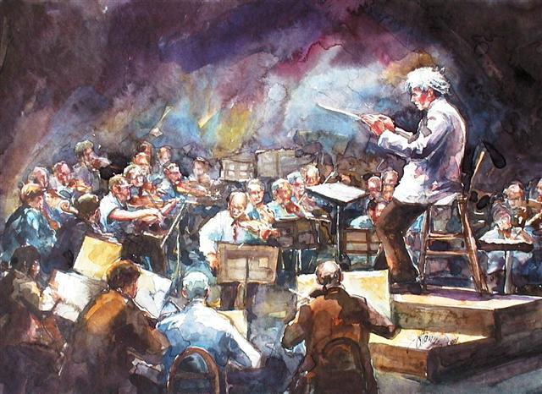
evangelizare pauperibus
misit me
The very charism of the Founders appears as an “experience of the Spirit,” transmitted to their disciples

Slide 4
charism

Slide 5
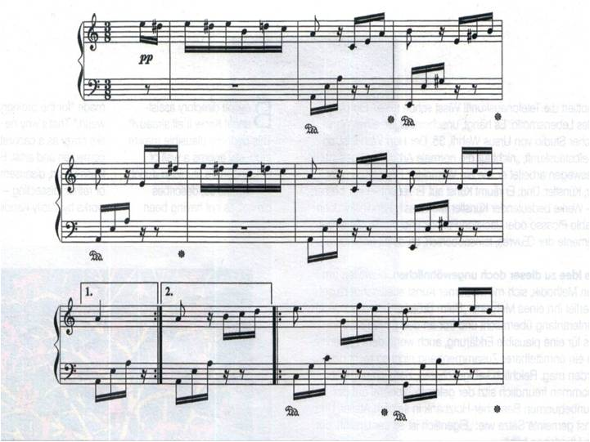
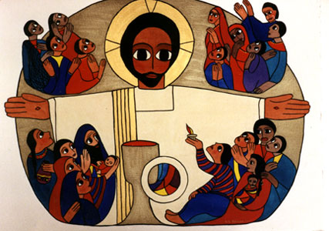
THE HOLY SPIRIT
GIVES THE CHARISMS
NECESSARY TO THE CHURCH TO FULFIL
ITS MISSION
Notes:
EM for prayer

Slide 6

GOD CALLS A PERSON TO
EXPERIENCE
A SPECIFIC WORD OR ASPECT OF GOD

Slide 7
GOD CALLS A PERSON
TO EXPERIENCE
TO LIVE
TO INCARNATE
A SPECIFIC WORD OF GOD

Slide 8
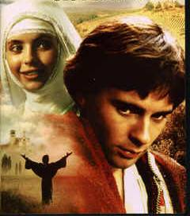
He emptied Himself, taking the form of a slave,
and being made in the likeness of men.
He humbled Himself
by becoming obedient
to the point of death,
even death on a cross…
Phil 2:7-8
POVERTY

Slide 9
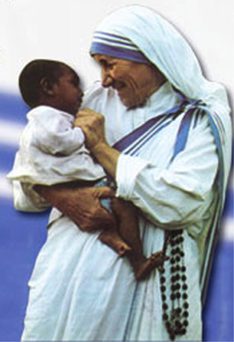
In so far as you did this
to one of the least of these
brothers of mine,
you did it to me.
Mat 25:40
JESUS IN
THE OTHER

Slide 10
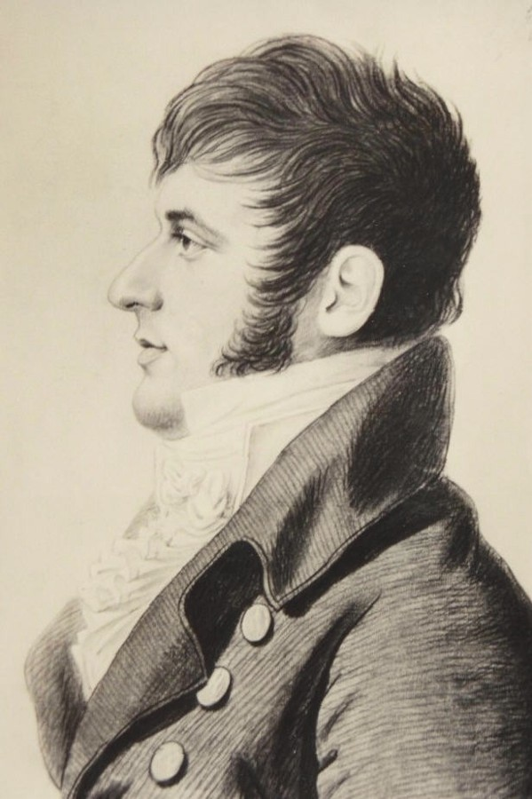
?

Slide 11
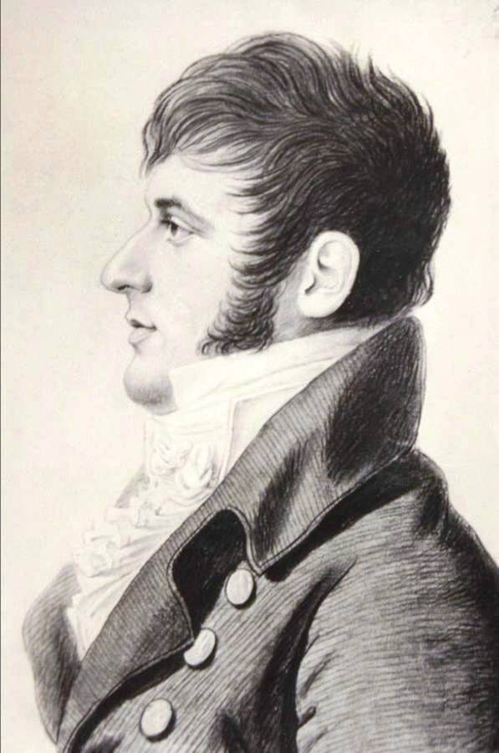
WHO IS GOD FOR ME ?
MY MERCIFUL SAVIOUR

Slide 12
WHO AM I?
I AM A MAN MADE FREE

Slide 13
WHAT MUST I DO ?
ALL FOR GOD
  (oblation)

Slide 14
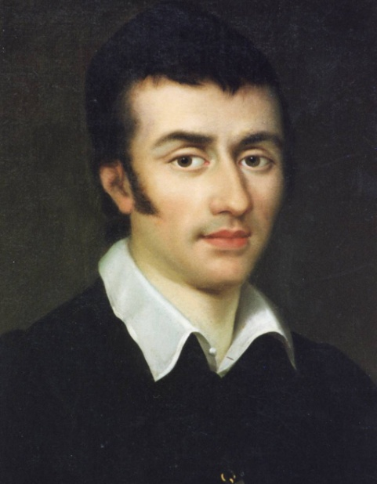
The Spirit of the Lord
has been given to me
because I have been anointed
to preach the Good News
to the poor …
Luke 4:18
coopERATOR
OF THE SAVIOUR

Slide 15
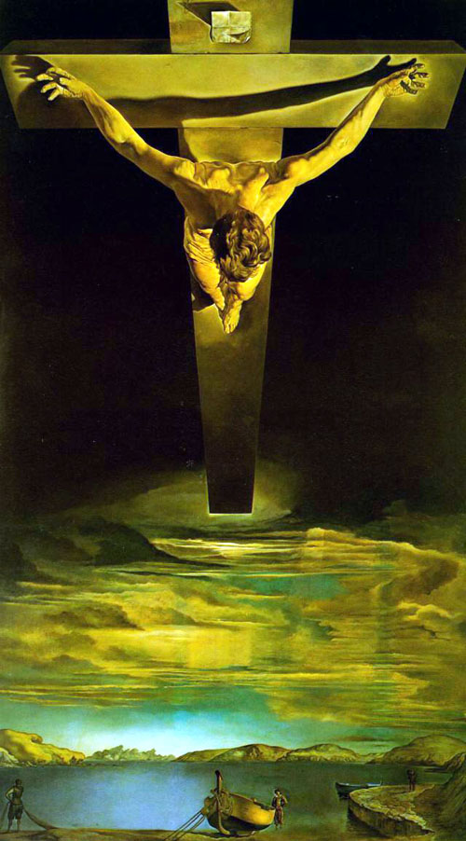
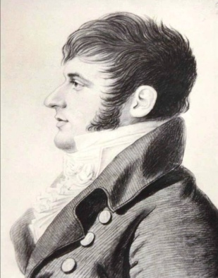
The charism of Saint Eugene de Mazenod was born when he experienced and understood God’s love for him

Slide 16
He began to see himself and other persons through new eyes:
the eyes of God’s love for all people

Slide 17

He began to see himself and other persons through the eyes of the Crucified Saviour

Slide 18
So powerful and wonderful was this experience of being liberated, that he understood what his life-vocation was:

Slide 19

LEAD OTHERS TO
HIS SAME EXPERIENCE

Slide 20
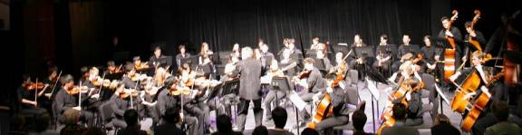
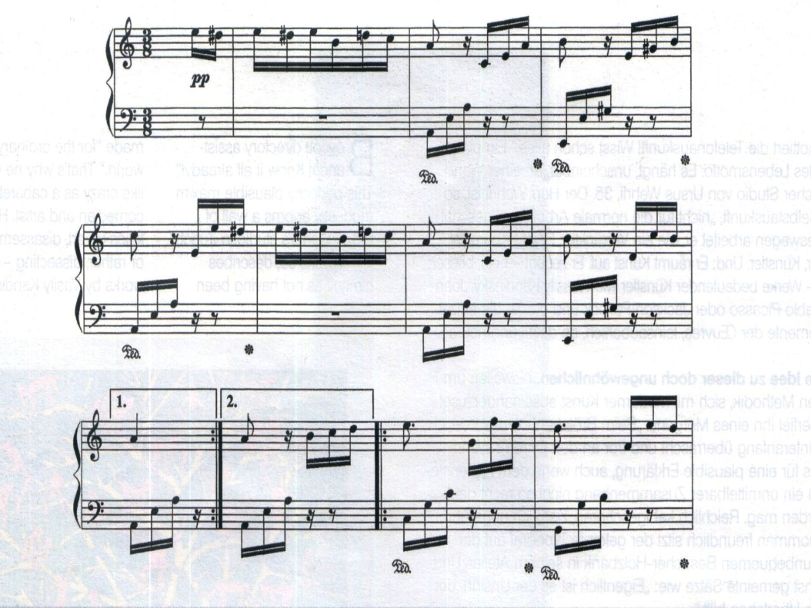

THE PERSON LIVES
THAT SPECIFIC ASPECT OF GOD
IN THE WORLD’S
SITUATION OF NEED

Slide 21
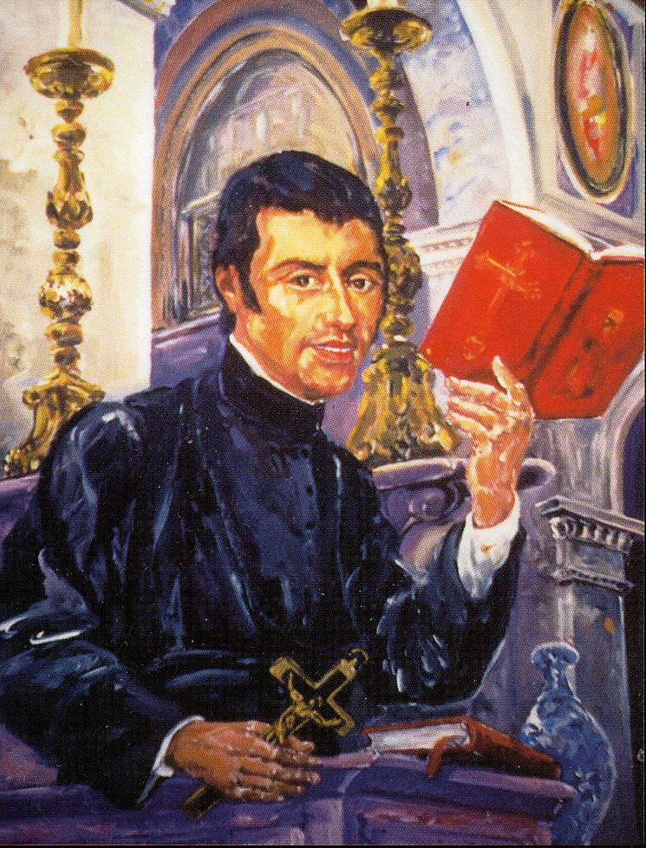
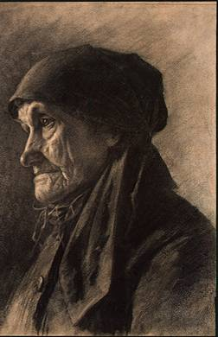
LEAD OTHERS TO HIS SAME EXPERIENCE OF GOD AS MERCIFUL SAVIOUR
Notes:
GOD CALLS A PERSON TO LIVE AND INCARNATE A SPECIFIC EXPERIENCE OF GOD

Slide 22
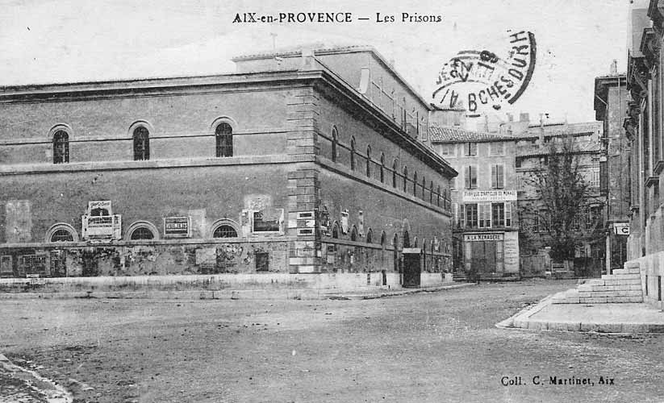
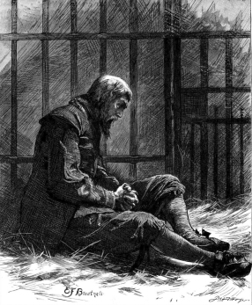
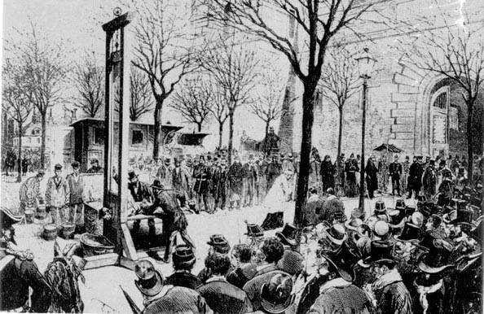
LEAD OTHERS TO
HIS SAME EXPERIENCE

Slide 23
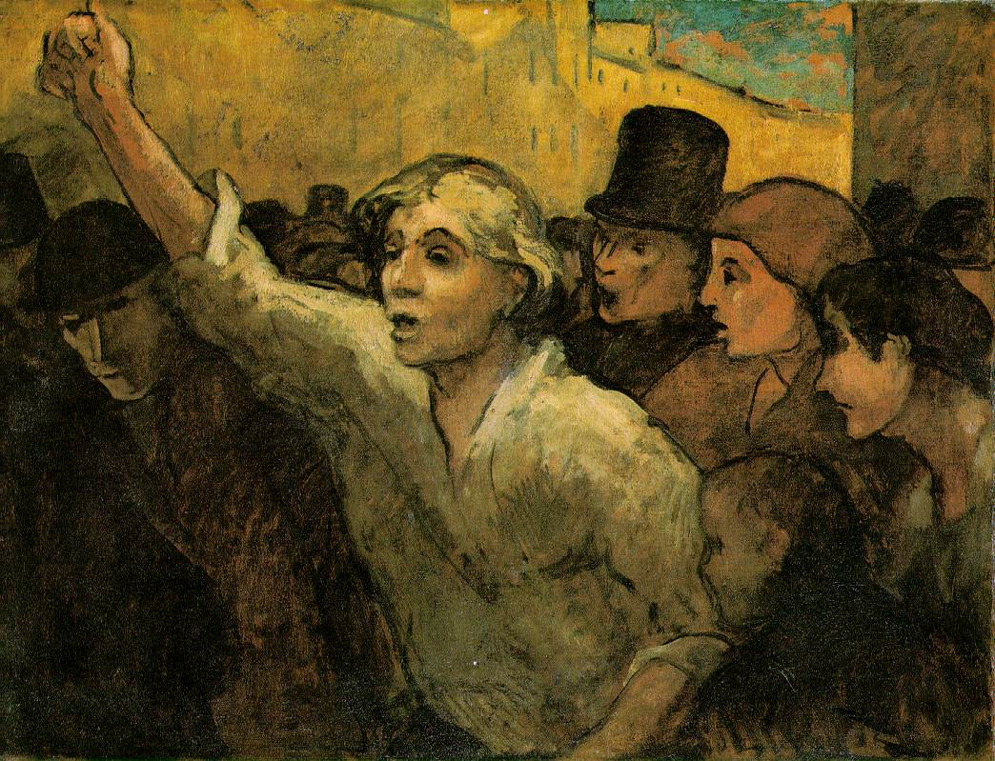
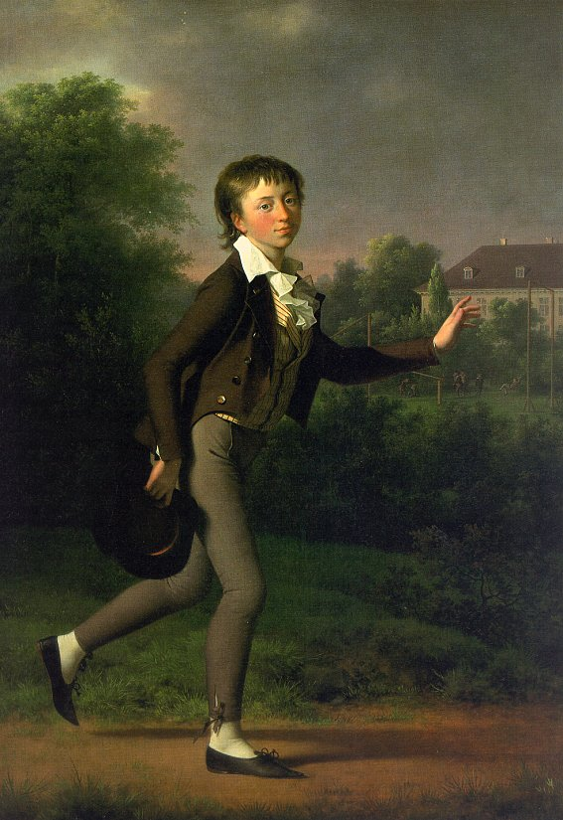
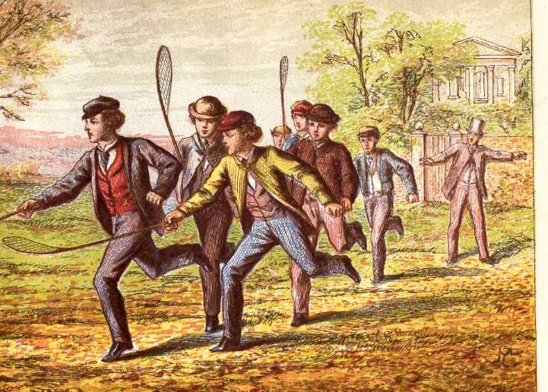
LEAD OTHERS TO
HIS SAME EXPERIENCE

Slide 24
GOD INSPIRES OTHERS TO JOIN THE PERSON IN LIVING THAT PARTICULAR GIFT

Slide 25
INITIALLY PRIESTS,
THEN BROTHERS

Slide 26
“The charism of Saint Eugene de Mazenod is a gift of the Spirit to the Church, and it radiates throughout the world.”
R 41b.

Slide 27
Lay people recognize that they are called to share in the charism according to their state of life, and to live it in ways that vary according to milieu and cultures.
R 41b.

Slide 28

IN TUNE WITH EUGENE
How did Eugene see us living his charism?

Slide 29
IN TUNE WITH EUGENE
What does it mean to be Oblate?

Slide 30
1/ Personal relationship with Jesus Christ:
have an “Oblate“ spirituality
THE ESSENTIAL CONDITIONS FOR
BEING AN OBLATE
3/ Mission to the most abandoned:
lead them to the same experience
2/ Form part of an apostolic community

Slide 31
SPIRITUALITY
COMMUNITY
MISSION.

Slide 32
WHAT LEVEL OF BELONGING ????
OBLATE/ JESUIT/OFM
PARISH

Slide 33
WHAT LEVEL OF BELONGING ????
THOSE WHO FEEL A
VOCATION
TO LIVE THE OBLATE CHARISM

Slide 34
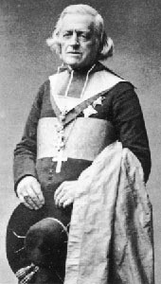
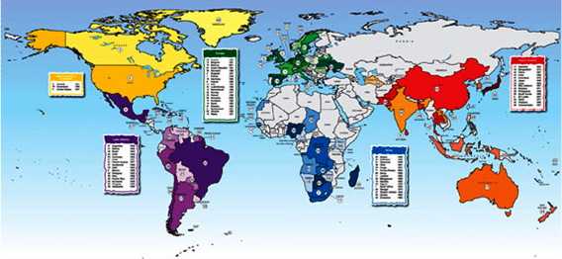

2009: 67 countries
1816 Aix

Slide 35

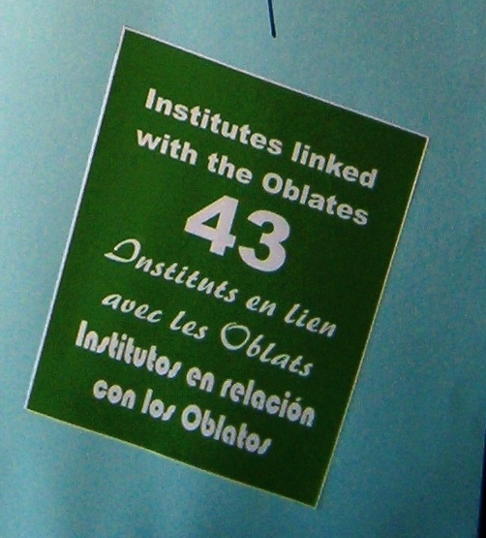
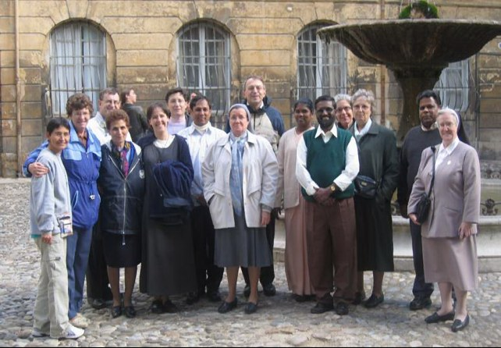

Slide 36
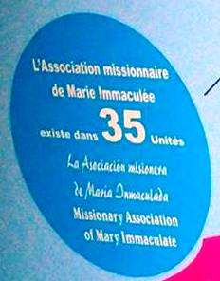
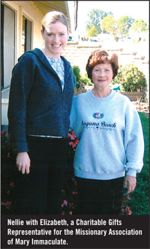
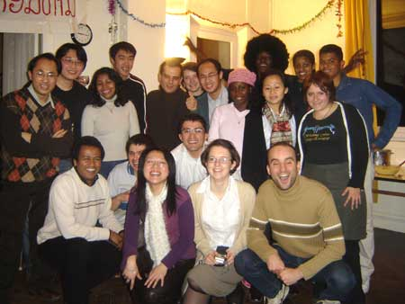
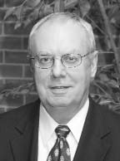
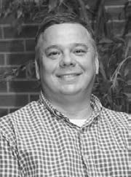

Slide 37
CO-OPERATORS OF CHRIST THE SAVIOUR
by being our co-workers through
Prayer for us
Material help in our mission
Material help for our houses of formation
THEY FORM PART OF OUR EXTENDED FAMILY
M.A.M.I.

Slide 38
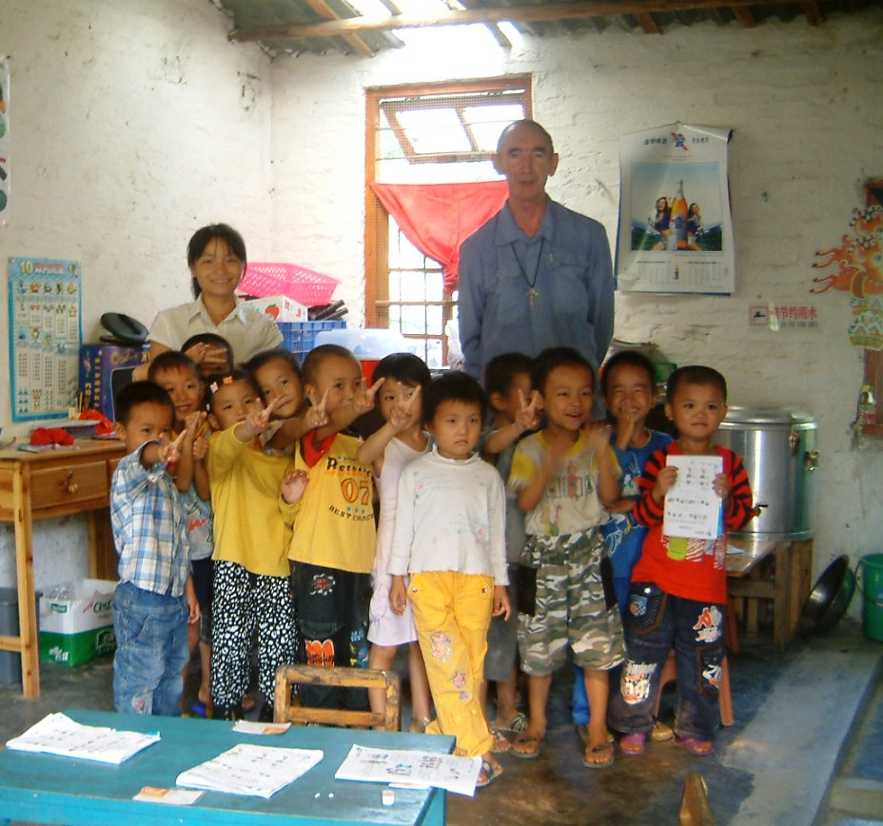
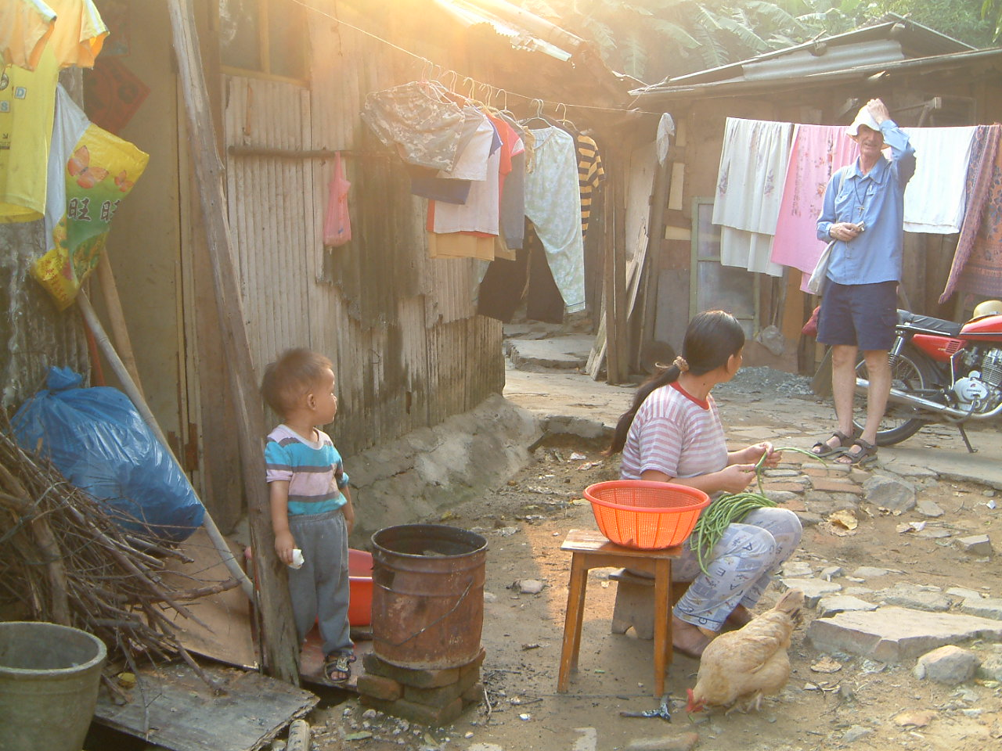

Slide 39

OBLATE YOUTH SERVICE
“Through our Service we strengthen our Faith”

Slide 40
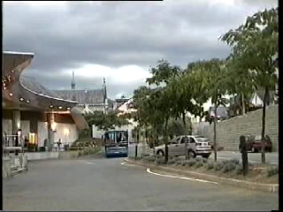
Notes:
Clip is 1:59 long

Slide 41
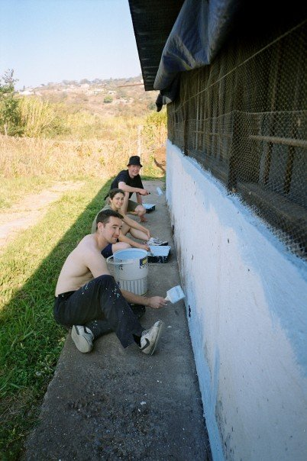
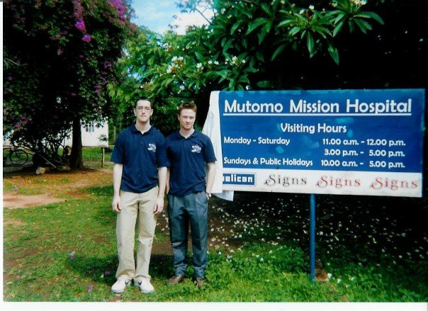
What do the OYS do?
South Africa - 2005
Our African Projects
Kenya - 2002
Notes:
In satisfying that desire to push their own boundaries a little bit, 2 OYS members (seen here) headed out to Africa in 2003 to work in Kenya. A further initial ‘step’ into South Africa was made by a group of 8 into South Africa to another project in 2005.

Slide 42
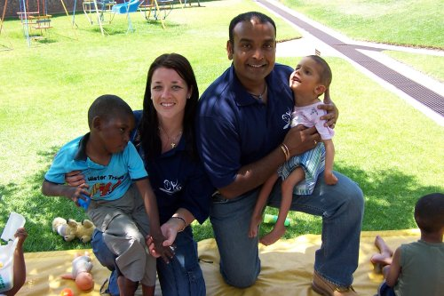
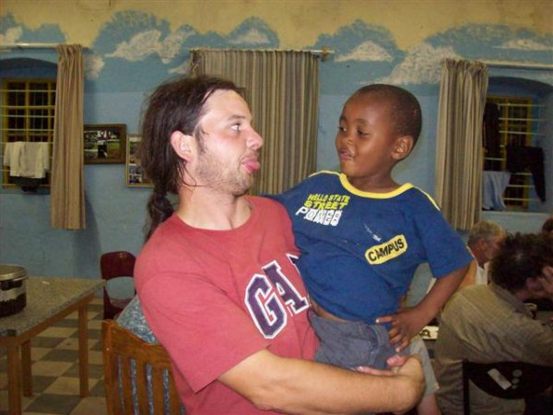
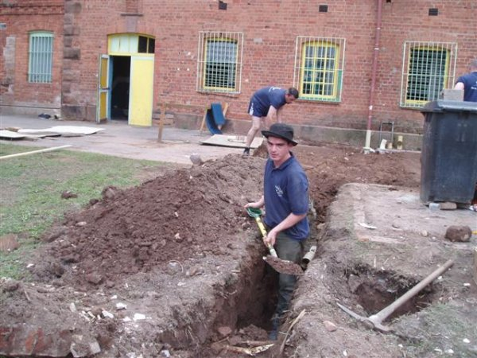
Streetwise, Little Eden and Sukumawenze
STREETWISE
A home for children who for various reasons have ended up living on the streets
Notes:
The second ‘step’ or ‘wave’ of the OYS working in Africa soon followed. We visited once again the Streetwise project which was home for children, who for various reasons have ended up on the streets. One of the main aims of the people working in Streetwise is to ultimately reunite these kids with their families. It soon became clear that the gang who visited Streetwise felt that they could use some of their gifts/skills/talents in order to improve the living conditions of the kids in Streetwise and they undertook a massive program of renovation which spread over a number of years and another phase was just completed this February.

Slide 43
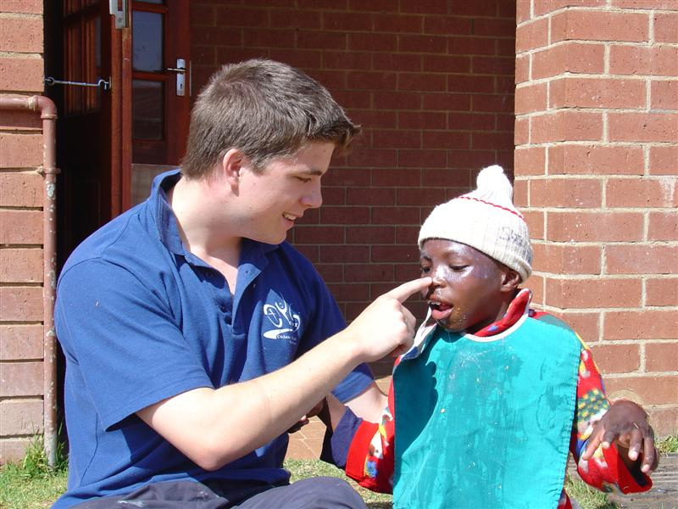
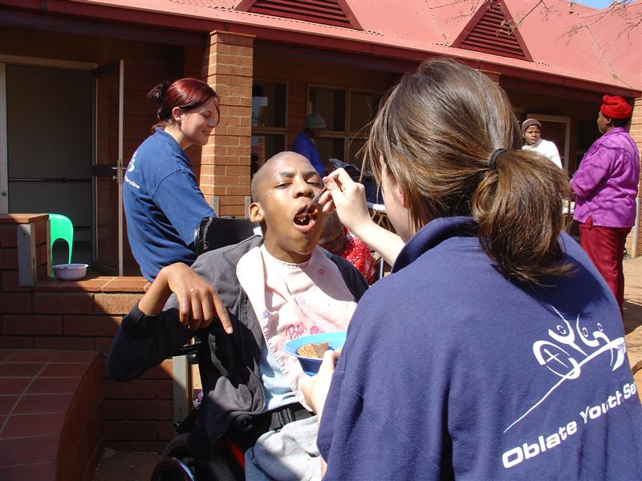
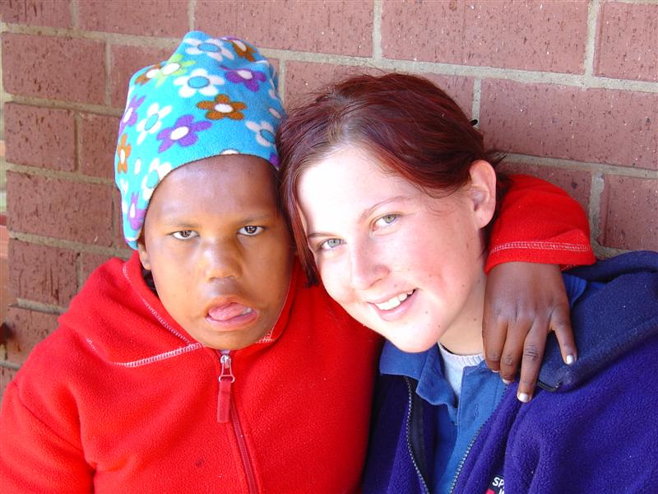
Streetwise, Little Eden and Sukumawenze
LITTLE EDEN
A home for 290 severely mentally and physically disabled children and adults
Notes:
Little Eden is a place that is special in my heart because I spent a couple of months in 2007 working their alongside a couple of other members. It is a home for 290 severely mentally and physically disabled children and adults spread over two sites in Johannesburg in South Africa. I’ll let the pictures speak for themselves.

Slide 44
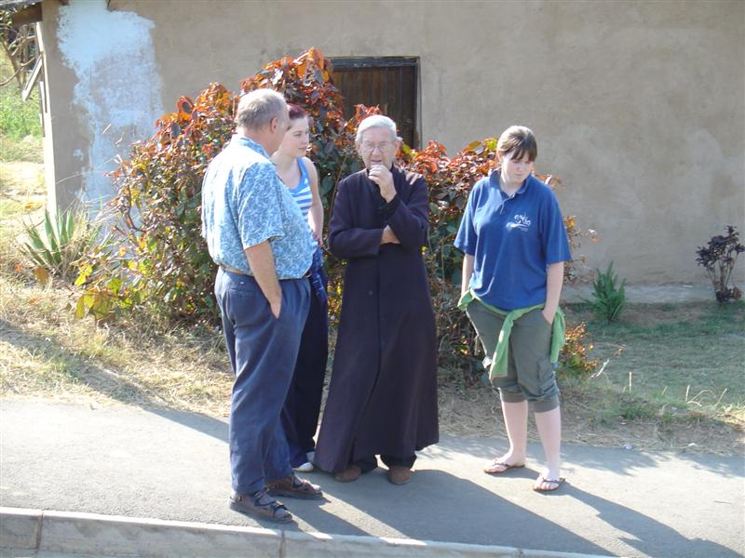
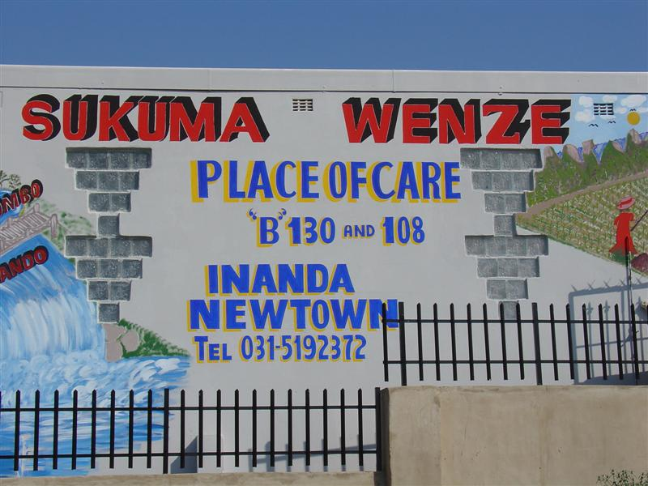
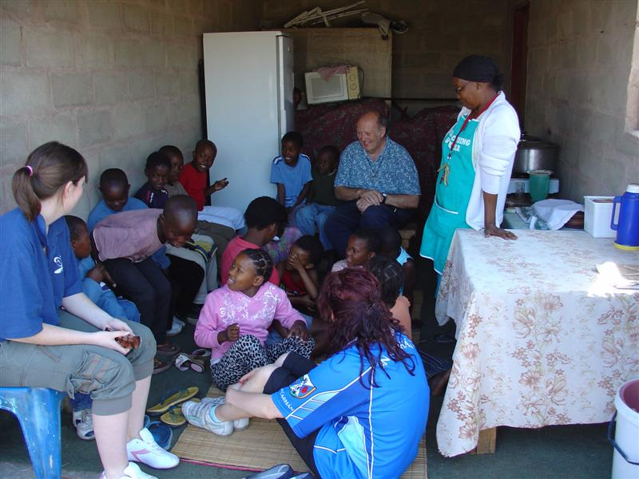
Streetwise, Little Eden and Sukumawenze
SUKUMAWENZE
An Oblate Mission founded by Fr. Paddy McMahon that gives terminally-ill patients dignity, peace and comfort in their final days
Notes:
The final place that we visited was ‘Sukumawenze’ in Durban which is an AIDS hospice founded by an Oblate named Fr. Paddy McMahon. The hospice has two main functions; the first is to provide terminally ill patients with dignity and comfort; the second is to feed over 300 kids daily at 4 feeding sites around Durban who would otherwise go hungry.
An amazing guy, Fr. McMahon is teaching the local kids (in his spare time) how to use computers. It should be noted that he is 96 years old. Understandably, due to the

Slide 45
Anglo-Irish Projects
Guest visiting program
Annual Lourdes reunion
Summer Camp 2010 – Wales for 12-14 year olds
New Groups in London, Anglesey and Edinburgh
Notes:
Now we have a short video clip of 3 OYS members giving us a brief insight into their respective roles in current OYS projects

Slide 46
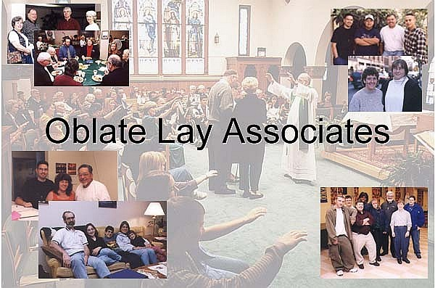
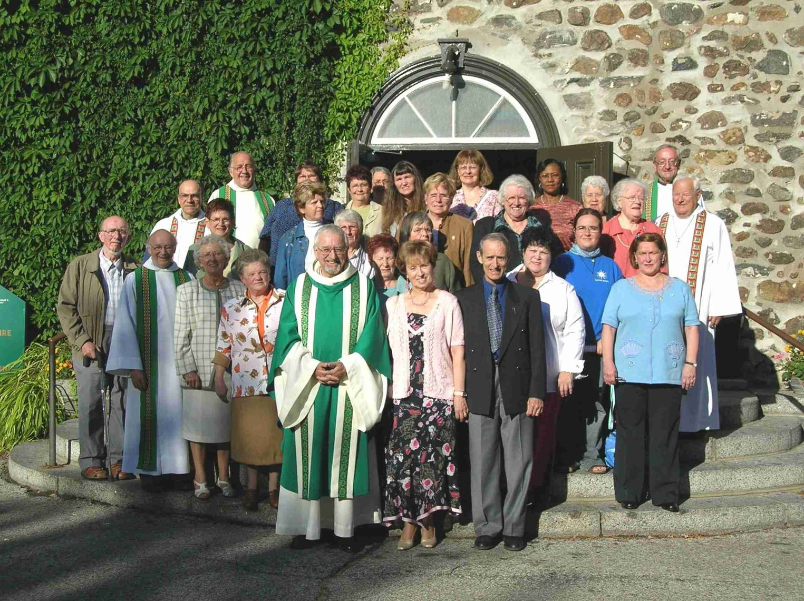
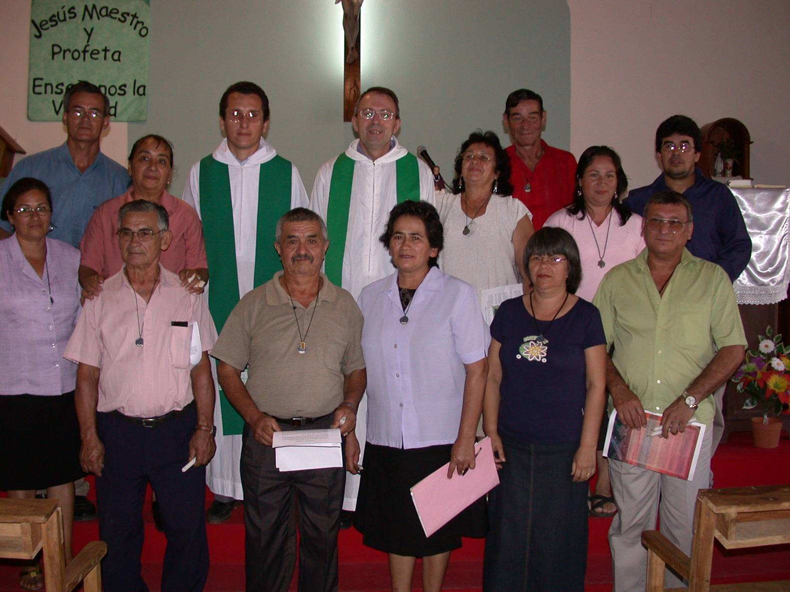
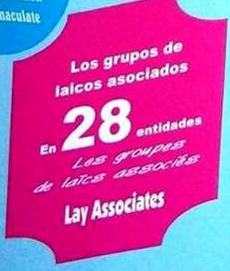

Slide 47

They are co-operators of Christ the Saviour
TOGETHER with us through
Committment to living the spirituality of St. Eugene
In apostolic communities linked with ours
According to a Rule accepted after a period of formation
Working with us to preach the Gospel to the most abandoned
THEY ARE PART OF OUR FAMILY
Lay Associates

Slide 48
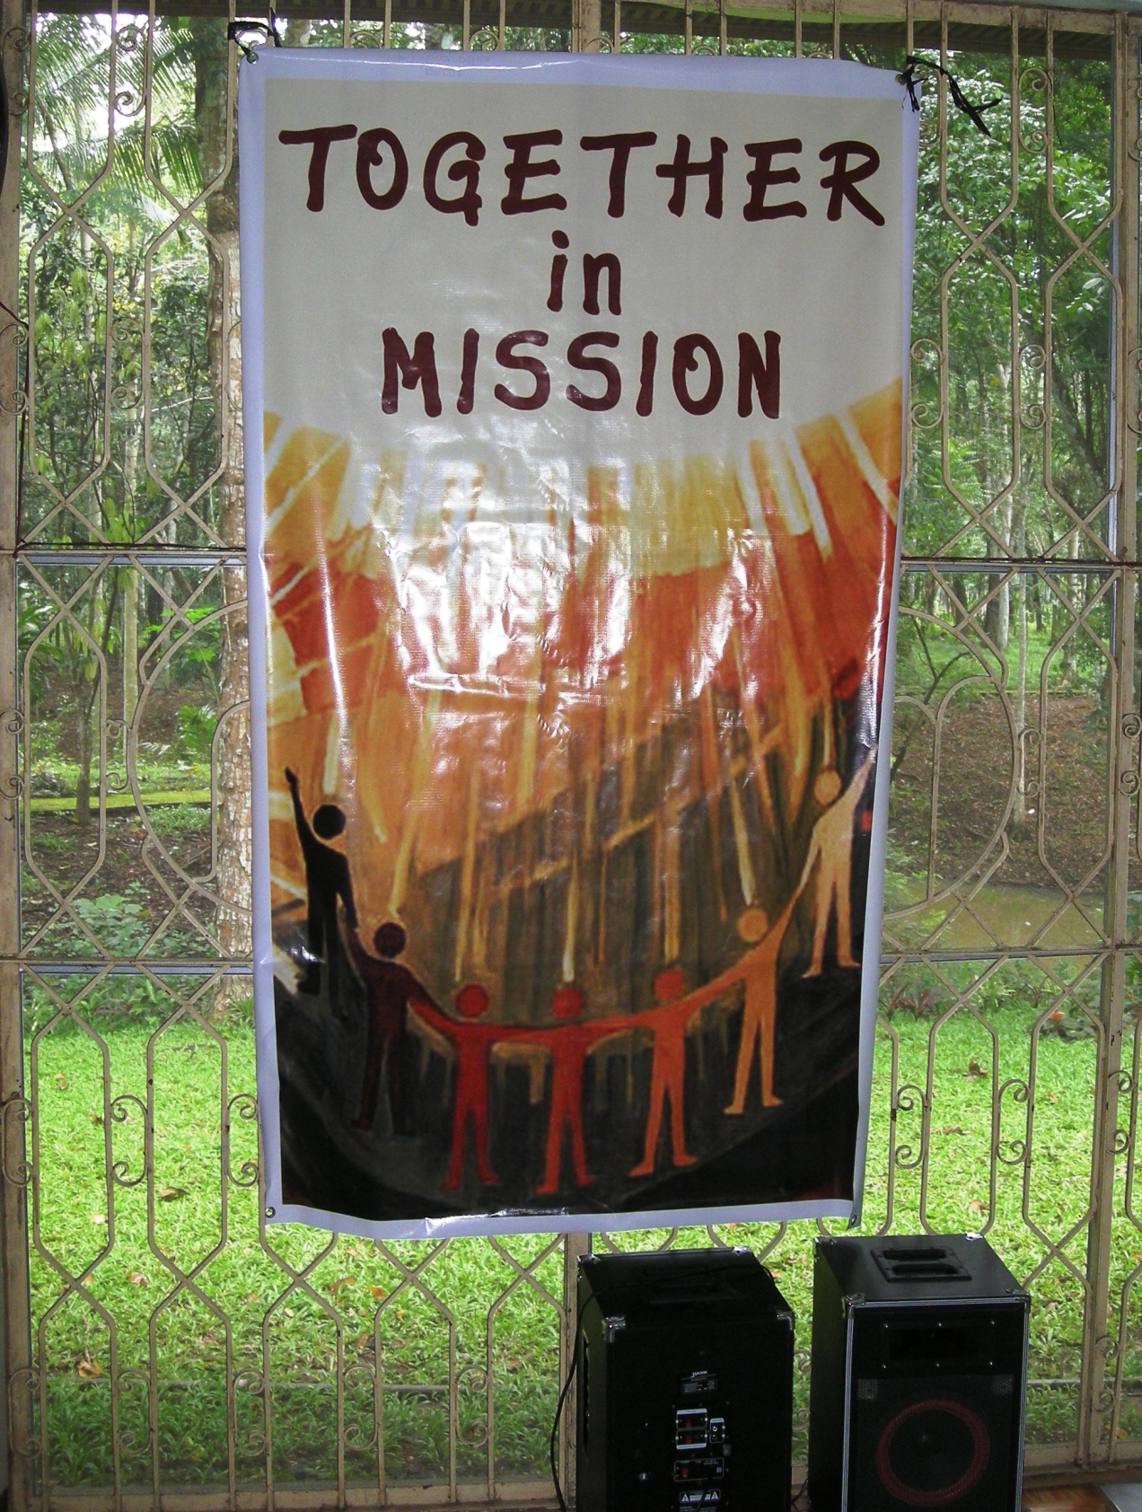

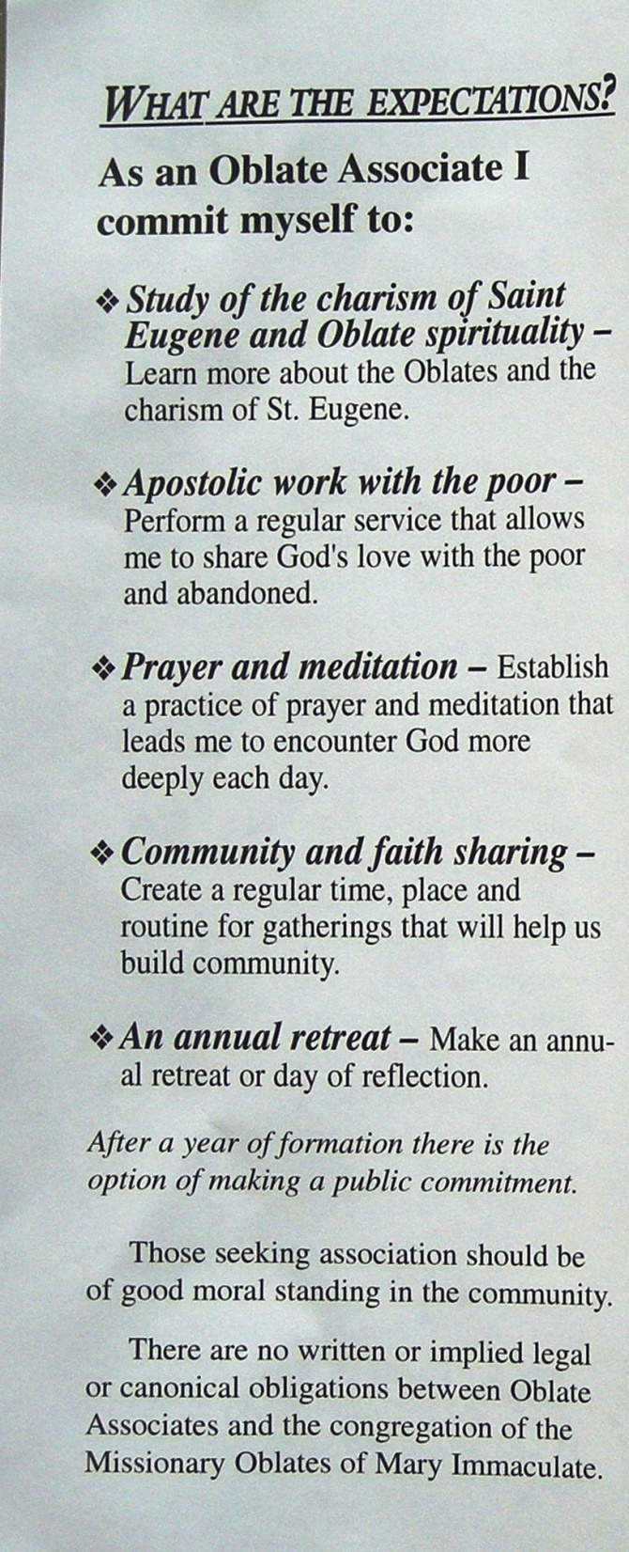

Slide 50


Slide 51
The Oblate Story in Birmingham to date
St. Eugene visited in 1850
Early foundations in the region included:
Grace Dieu; Aldenham and Maryvale;
More recent Oblate missions
IWIC (1957)
St Anthony & St John the Baptist, Kingshurst (1970-2007)
St. Michael’s (2004-2007)
Zaccaheus Centre

Slide 52
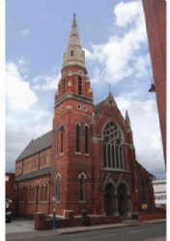
Today:
A number of Oblates from Birmingham minister in different parts of the world including South Africa and Australia.
St. Anne’s (1938-2010)

Slide 53

How can we continue to share in this Charism in this time of change?
Current Possibilities:
Oblate Retreat Centre:
Regularly make use of the facilities offered by Wistaston Hall in Crewe. Members of the parish community have the ongoing options of participating in Oblate sponsored events such as the short directed retreats, team building workshops etc.

Slide 54

Oblate Communications:
The community receives copies of the newsletter Oblate Connections. In other places where we have withdrawn from the newsletter continues to be sent and provides an ongoing way for people of the community to access the events that are taking place within the Oblate Family.
MAMI:
The Oblate missions throughout the world have been for many years very well supported through the local MAMI supporters. This provides a strong connection to not only to the Oblate mission but to the Church’s mission to the world.

Slide 55

Possible New Relationships:
Charism Group:
That we explore the establishment of a group like the “Friends of St. Eugene” where people come together on a regular basis in small groups and are nourished by the spirituality of St. Eugene.
Many Oblate Provinces have groups like these and sometimes they are called “Partners in Mission” or “Oblate Associates.” Each place would have to find a way that best suits their local needs.
Oblate Youth Service:
Over the last number of months the Oblates have been trying to establish new young adult groups in different parts of the UK as part of the OYS. This group works with people aged 18-30 and provides an opportunity for people to be involved both locally and in larger shared projects.
Is there a place for such a group in Birmingham?

Slide 56
Centred on the person of Jesus Christ, the source of our mission, we commit ourselves to a profound personal and communal conversion.”

